Slide 1

Diffie-Hellman Key Exchange
By: Israel O Akintomide, Ibrahima Balde, Larry Baucum, Tyree Black, Malachi Clark, LaTreil Wimberly, & Devin Young,
CTEC445-101
Dr. Lethia Jackson
February 16th, 2025

Slide 2
INTRODUCTION
The Diffie-Hellman Key Exchange is a cryptographic method used to securely share a secret key over a public channel.
It allows two parties to generate a shared secret without directly exchanging it.
In this simulation, we use colors instead of numbers to illustrate the concept.

Slide 3
What is Diffie-Hellman?
A method to share a secret key over an insecure channel (like the internet).
Two parties use math to create a shared key that no one else can figure out.
The shared key is used to encrypt and decrypt messages between them.
The key is never directly exchanged over the internet.

Slide 4
Why is it Important?
Keeps data private: Ensures that only the sender and receiver can read the messages.
Protects against eavesdropping: Even if someone listens to the conversation, they can’t steal the key.
Modern: Ensures secure communication without needing to meet in person.

Slide 5
Advantages
Secure Key Sharing: It lets two people share a secret key without anyone else knowing it.
Doesn’t Need Pre-Sharing: No need to meet in person to share a key.
Efficient: Fast and easy to use.
Mathematical Security: Based on difficult-to-solve problems like discrete logarithms, making it computationally hard to break.
Widely Used: Implemented in various security systems, including secure messaging apps and online banking.

Slide 6
Vulnerabilities
Man-in-the-middle Attacks: Allow attackers to intercept the Diffie-Hellman Key Exchange by intercepting the two parties and creating a secret key with each party (Tutorialspoint, 2024). This means that there should be a secure channel present when using the Diffie-Hellman Key Exchange.
Replay Attacks: Allows an attacker to intercept a message and replay it later to breach a system (Tutorialspoint, 2024). Because the Diffie-Hellman Key Exchange does not natively use digital signatures to verify the integrity of a message there is room for messages to be tampered with (Tutorialspoint, 2024).

Slide 7
Mitigating Threats
Non-Repudiation Techniques: Utilizing digital signatures and timestamps will ensure that the sender of the message was the user that sent the message instead of a malicious user intercepting the messages (Kurosawa & Ogata, 2002).
Digital Certificates: These can be used to validate the user to ensure they are the actual individual being authorized to access this website or service, and these digital certificates are usually issued by a trusted Certificate Authority (CA).

Slide 8
Real World Scenarios
VPN – The first connection between the server and the user is created using the Diffie-Hellman Algorithm by establishing a shared secret key that is used for encrypting and decrypting the communications (Tutorialspoint, 2024).
Online Banking – Diffie-Hellman allows the online banking system and a user's machine to create a secret key to be used for encrypting and decrypting the communication between the users and online banking systems (Tutorialspoint, 2024).

Slide 9
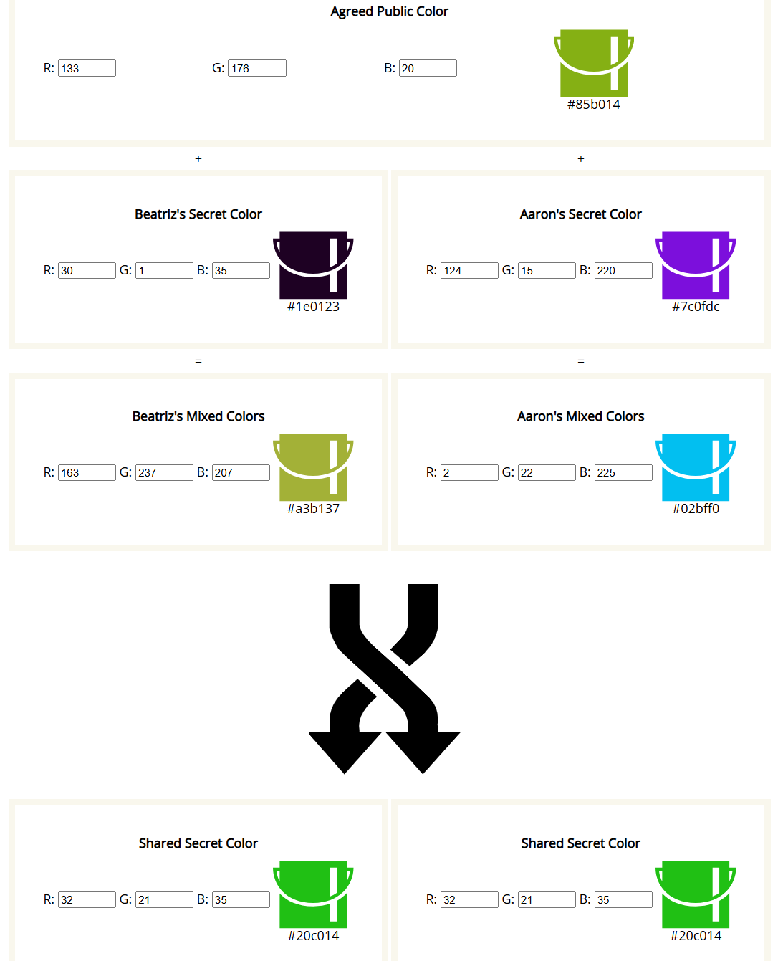
Diffie-Hellman Color Simulation
Shared Public Color: #85b014
Beatriz Secret Color: #1e0123
Aaron Secret Color: #7c0fdc
Shared Secret Color: #20c014
We could not guess our groupmates secret colors. Showing the effectiveness of the Diffie-Hellman Key Exchange.

Slide 10
References
Applications and limitations of Diffie-Hellman algorithm. Tutorialspoint. (n.d.). https://www.tutorialspoint.com/applications-and-limitations-of-diffie-hellman-algorithm
Panagiotopoulos, I., & Dimitrakopoulos, G. (2018). Diffie–Hellman process and its use in secure and authenticated VC networks. IET Intelligent Transport Systems, 12(9), 1031–1037. https://doi.org/10.1049/iet-its.2018.5263
Kurosawa, K., & Ogata, W. (2002). Nonrepudiation in Diffie-Hellman key exchange. In Advances in Cryptology – ASIACRYPT 2002: 8th International Conference on the Theory and Application of Cryptology and Information Security (pp. 126-140). Springer. doi:10.1007/3-540-36231-2_9
Van Oorschot, P. C., & Wiener, M. J. (1996). On Diffie-Hellman key agreement with short exponents. Advances in Cryptology — EUROCRYPT '96, Lecture Notes in Computer Science (Vol. 1070, pp. 332–343). Springer. https://doi.org/10.1007/3-540-68339-9_29

